Slide 1
Gate-Level Minimization
Mano & Ciletti
Chapter 3
By Suleyman TOSUN Ankara University

Slide 2
Outline
Intro to Gate-Level Minimization
The Map Method
2-3-4-5 variable map methods
Product-of-Sums Method
Don’t care Conditions
NAND and NOR Implementations

Slide 3
Gate-Level Minimization
Finding an optimal gate-level implementation of Boolean functions.
  Difficult to perform manually.
  Can use computer-based logic synthesis tool
    Exp: espresso logic minimization software
  Karnough Map (K-map) can be used for manual design of digital circuits.

Slide 4
The Map Method
The truth table representation of a function is unique.
But, not the algebraic expression
  Several versions of an algebraic expression exist.
  Difficult to minimize algebraic functions manually.
The map method is a simple proceure to minimize Boolean functions.
  Pictorial form of a truth table.
  Called Karnough Map or K-Map.

Slide 5
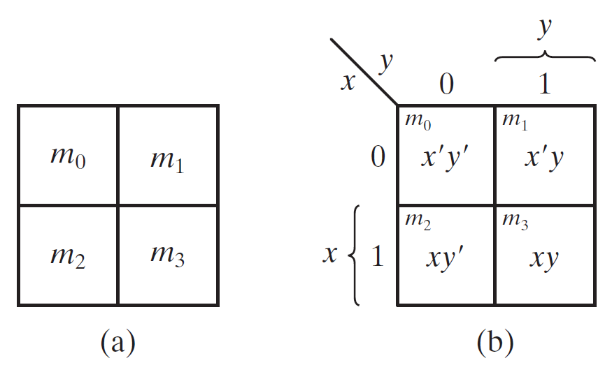
Two-Variable Map
Four Minterms
Two variables
Four squares for four minterms
Figure b shows the relationship between the squares and the variables x and y.

Slide 6
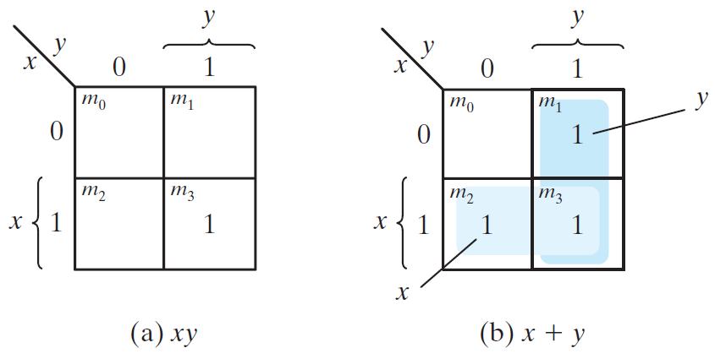
Two-Variable Map (Cont.)
May only be useful to represent 16 Boolean functions.
  Exp: If m1=m2=m3=1 then
  m1+m2+m3=x’y+xy’+xy=x+y (OR function)

Slide 7
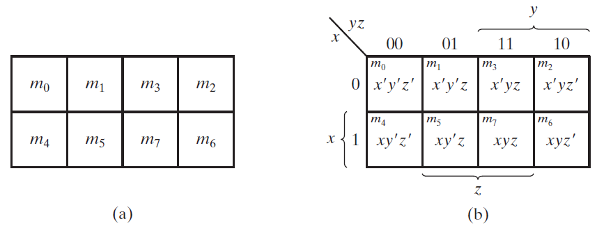
Three-Variable Map
There are 8 minterms for 3 variables.
So, there are 8 squares.
Minterms are arranged not in a binary sequence, but in sequence similar to the Gray code.

Slide 8
Three-Variable Map (Cont.)
The square for square m5 corresponds to row 1 and column 01 (101).
Another look to m5 is m5=xy’z.
When variables are 0, they are primed (ex: x’). Otherwise not primed (x).

Slide 9
Three-Variable Map (Cont.)
Two adjacent squares differs one variable (one primed other is not).
  So, they can be minimized
  Ex: m5+m7=xy’z+xyz=xz(y’+y)=xz
So, try to cover as many adjacent squares as possible by the orders of two.
  1,2,4,8… squares that has the logical value1.

Slide 10
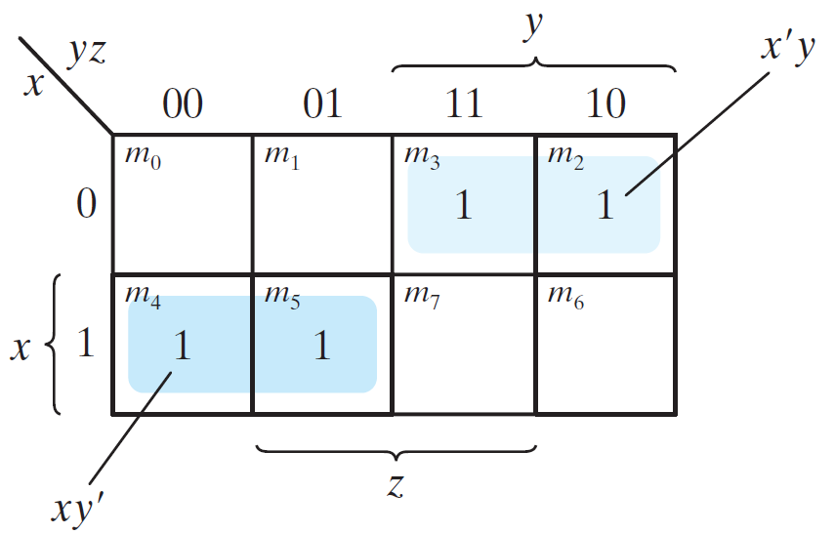
Example 1
Simplfy the Boolean function
  F(x,y,z)=Σ(2,3,4,5)
  F(x,y,z)=x’y+xy’

Slide 11
Adjacent squares
Some adjacent squares don’t touch each other.
  m0 is adjacent to m2 and m4 is adjacent to m6.
  m0+m2=x’y’z’+x’yz’=x’z’(y’+y)=x’z’
  m4+m6=xy’z’+xyz’=xz’(y’+y)=xz’

Slide 12
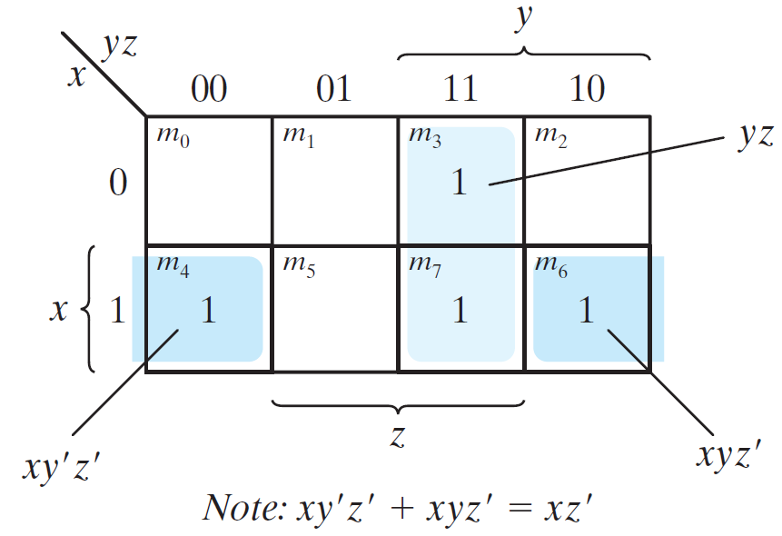
Example 2
Simplfy the Boolean function
  F(x,y,z)=Σ(3,4,6,7)
  F(x,y,z)=yz+xz’

Slide 13
One square represents one minterm, giving a term with three literals
Two adjacent squares represent a term with two literals
Four adjacent squares represent a term with one literal
Eight adjacent squares encompass the entire three-variable map and produce a function that is always equal to 1.

Slide 14
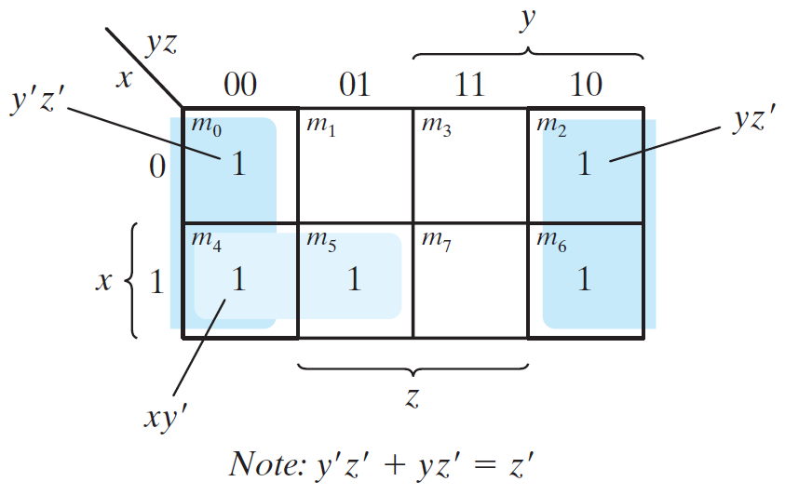
Example 3
Simplfy the Boolean function
  F(x,y,z)=Σ(0,2,4,5,6)
  F(x,y,z)=z’+xy’

Slide 15
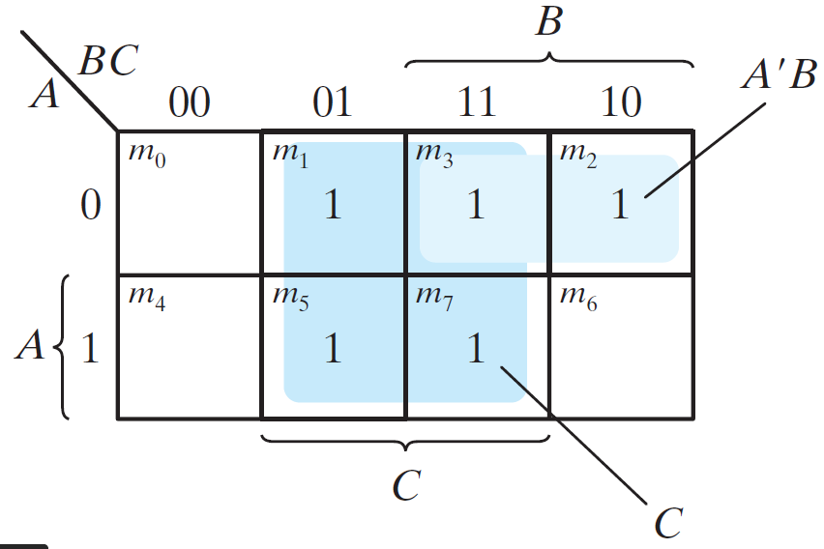
Example 4
F=A’C+A’B+AB’C+BC
  Express F as a sum of minterms.
    F(A,B,C)=Σ(1,2,3,5,7)
  Find the minimal sum-of-products expression
    F=C+A’B

